Slide 3
1st Year | Junior Cert Year | Subjects
2014/15 | Junior Cert 2017 | English
2015/16 | Junior Cert 2018 | English
2016/17 | Junior Cert 2019 | + Science & Business
2017/18 | Junior Cert 2020 | + Irish, French & Visual Art
2018/19 | Junior Cert 2021 | + Maths, Home Economics, Music, Geography & History
2019/2020 & future years | Junior Cert 2022 | + Wood Technology, Engineering & Graphics

Slide 4
Subjects
Students can study a maximum of 10 subjects for their Junior Cycle
Short courses can replace some subjects
Higher/Ordinary Level: English, Irish, Maths
Common Level: Science, French, History, Geography, Business Studies, Wood Technology, Engineering, Music, Visual Art, Home Economics, Graphics

Slide 5
Wellbeing (from 1st year 2017)
300 hours over 3 years moving to 400 hours over 3 years by 2020
SPHE, CSPE, PE, Guidance, IT etc.
Some parts may be listed as short courses

Slide 8
Classroom Based Assessments
Carried out in class – timetable set by Department
Most subjects - one in 2nd year, one in 3rd year (per subject)
Graded by subject teacher
Reported on Junior Cert Profile of Achievement
Exceptional
Above Expectations
In Line with Expectations
Yet to meet expectations

Slide 9
Ensuring quality
Schools will organise “Subject Learning and Assessment Review” meetings
Teachers will compare their assessment of students’ work and ensure a common approach across the school
CPD will be provided for teachers to ensure that the Classroom-Based Assessments align to a national standard

Slide 10
Assessment Task
Worth 10% of final result
Based on what was learned during 2nd CBA
Carried out in class and sent to SEC for marking. Mark is added to written state exam, no separate result is given
Practical subjects (Science, Visual Art, Music, Home Economics, Wood Technology, Engineering & Graphics) will have a practical element for the Assessment task

Slide 11
Written State Examinations
Worth 90% of final result
Duration of 2 hours
Exams will be set, run & corrected by the State Examinations Commission in June of third year.

Slide 12
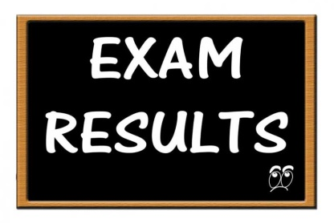
Grades for written exams
Distinction 90-100%
Higher Merit 75 – 89%
Merit 55- 74%
Achieved 40 – 54%
Partially Achieved 20 – 39%
Not Graded 0 – 19%

Slide 13
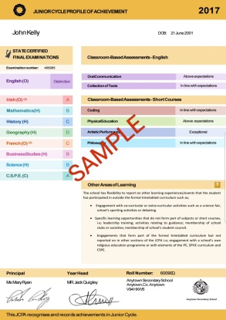
Junior Cert Profile of Achievement
Received by students at end of term after Junior Cycle (approx December)
Contains:
State Examinations Results
Classroom Based Assessments
Short Courses
Other Areas of Learning
Includes areas like SPHE, PE, participation in school activities e.g. Student council, team sports

Slide 14
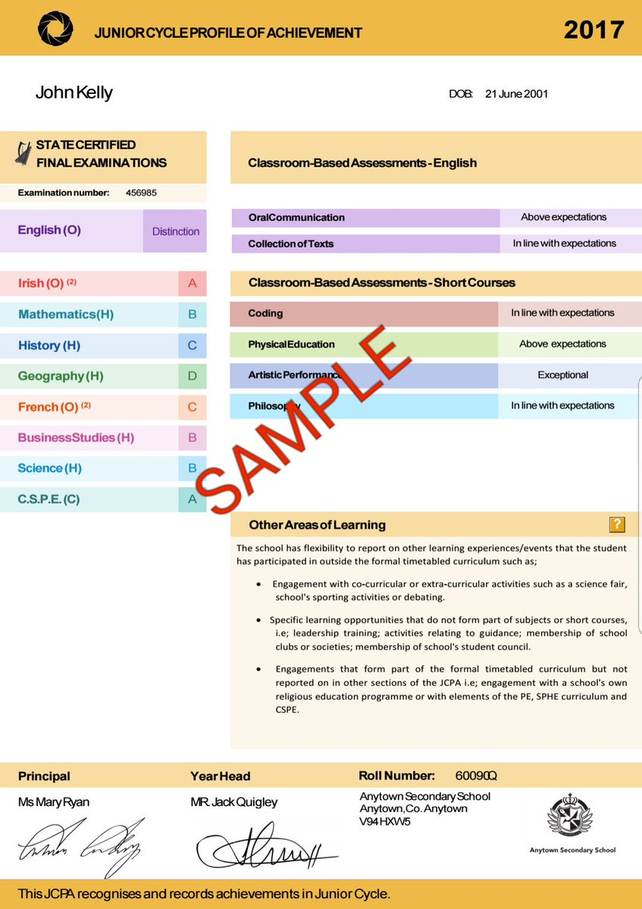

Slide 15
Questions

